Slide 1
Comparative Analysis of
measures of Veterans Affairs Hospitals
between the states of Georgia and Virginia.
75%
95%
Death Rate between Virginia and Georgia in-state facilities
Patient Safety Indicators PSIs, developed by the Agency for Healthcare Research and Quality AHRQ, are administrative data-based indicators that identify potential in-hospital patient safety events.
Re Admission-Rate between Virginia and Georgia in-state facilities
This analysis, presents findings from dataset posted on Homeland Infrastructure Foundation-Level Data (HIFLD).
Veterans Health Administration Medical Facilities dataset includes Veteran Affairs hospitals, Veteran Affairs Residential Rehabilitation Treatment Programs (RRTP), Veteran Affairs Nursing Home Care Units (NHCU), and more.

Slide 2
Patient Safety Measures A Routinely Collected Hospital Data
A potential preventability of the complication, and the ability of the indicator to identify medical error.
Safety Measure
Matrix
Data Used
Governance
These indicators serve as flags for potential quality problems (adverse events) rather than provide definitive measures of quality of care.
The PSI module contains 11 hospital-level indicators that reflect the quality of care provided by hospitals.
Dataset for the Patient Safety Indicator (PSI) module for the range of October 2012 to September 2015.
According to the AHRQ, these indicators are selected based on their ability to screen out conditions present on admission from conditions that develop after admission,

Slide 3
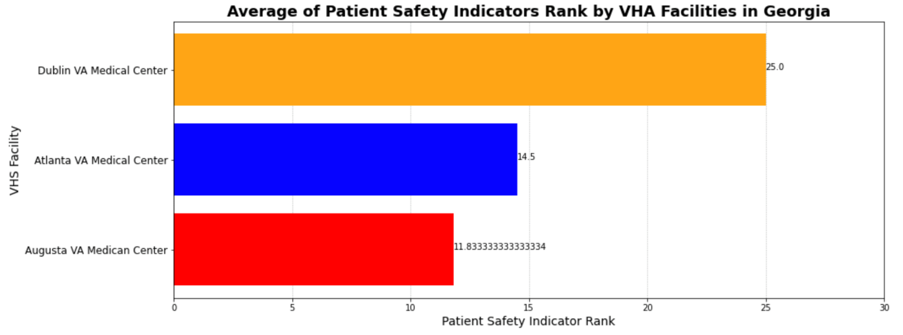
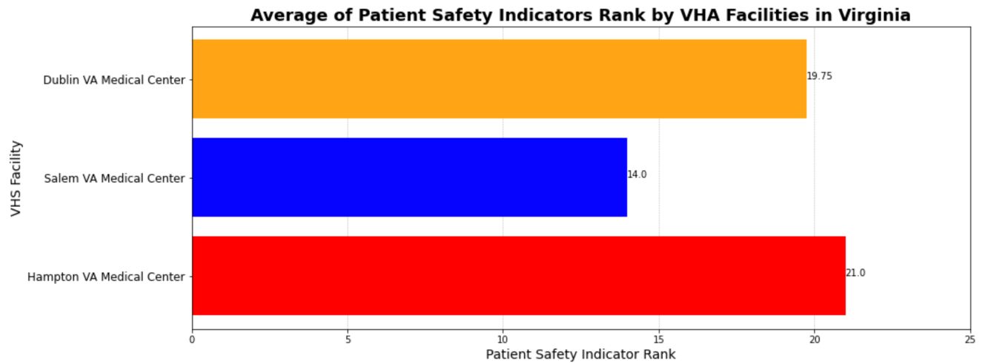
Average of Patient Safety Indicators Rank by Hospitals in Georgia and Virginia
Objective
Compare Patient Safety Indicator Ranks between different measures. Calculate rank for each measure by hospital and the average PSI overall by hospital.
O
Main Pandas and Matploitlab code used
Data-frames, ranks, horizontal bars (barh) and adding labels to each bar applying ax1.
C
Your Title
A good business plan starts with an executive summary of the business goals
AB
Your Title
A
A good business plan starts with an executive summary of the business goals

Slide 4
Average of Patient Safety Indicators Rank by Hospitals in Georgia and Virginia
Objective
Compare Patient Safety Indicators across Georgia and Virginia states.
Conclusion
This study analyzed PSIs from Department of Veterans Affairs VA discharge data. For Patients to choose their condition and select state for their treatment.
03 - Pressure Ulcer: Georgia
06 - Iatrogenic Pneumothorax: Virginia
07 - CLAB Infections: Georgia
08 - Postop Hip Fracture: Virginia
09 - Postop Hemorrhage or Hematoma: Virginia
10 - Postop Physiologic and Metabolic Derangements: Virginia
11 - Postop Respiratory Failure: Georgia
12 - Postop Pulmonary Embolism or DVT: Georgia
13 - Postop Sepsis: Georgia
14 - Postop Wound Dehiscence: Georgia
15 - Accidental Puncture or Laceration: Georgia

Slide 5
Analysis Details:
The current comparison is done only using Patient observation data relative to the individual hospitals average per state.
An observed rate is defined as the number of events of interest (numerator) divided by the population at risk (denominator).
For hospital-level observed rates, the populations at risk are derived from hospital discharge records. The AHRQ software program calculates observed PSI rates regardless of the number of cases available.
The purpose of the analysis determines which rates one should use in evaluating the performance of a hospital.
Fact:1
Fact:2
If the user‘s primary interest is to focus on a particular hospital, to identify cases for further follow-up and quality improvement without comparisons made to other hospitals, then he/she ought to simply examine the observed rate.
For the purpose of analysis to compare the performance of a particular hospital with national, state, or regional averages or performances of other selected hospitals, then all rates (observed, expected and risk-adjusted) should be examined.
35%
98%

Slide 6
Re-Admission Rates A Comparison amongst VHA’s Facilities
How often do patients return to hospital post discharge for treatment again.
Safety Measure
Matrix
Data Used
Governance
Based on the treatment Facility, we measure the Quality of care.
What are your chances to readmit post dicharge
Dataset of readmission for the range of October 2012 to September 2015.
According to the AHRQ, these metrics are used to care quality.

Slide 7
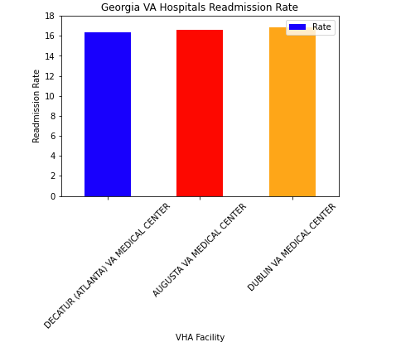
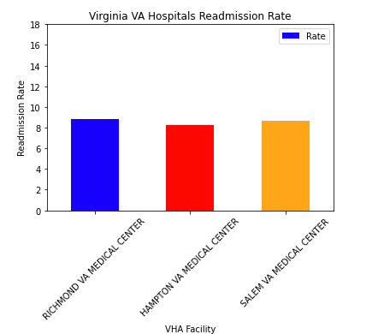
Readmission rate ranked by Hospitals in Georgia and Virginia
Objective
Use VA Hospital Readmission Rate data to display info and charts to help U.S Veterans make a more informed decision on which VA hospital he/she would prefer to be treated for their condition and avoid readmission
Conclusion
Comparing and analyzing the readmission rates, Georgia have double the chances of readmission as compared to care provided in Virginia.

Slide 8
Death Rates A Comparison amongst VHA’s Facilities
How often do patients pass while receiving care at the hospital.
Safety Measure
Matrix
Data Used
Governance
Based on the treatment Facility, we measure the Quality of care.
How often do patients pass at the hospital?
Dataset of death rates for the range of October 2012 to September 2015.
According to the AHRQ, these metrics are used to care quality.

Slide 9
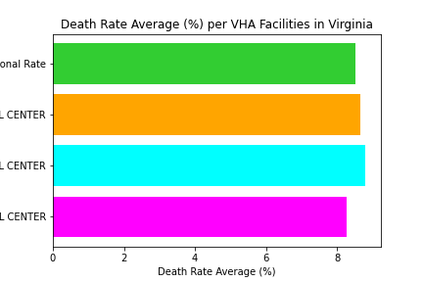
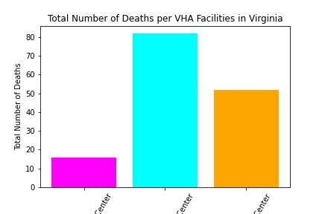
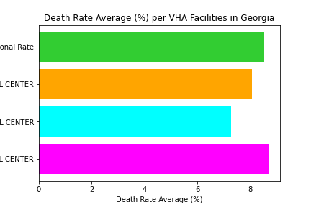
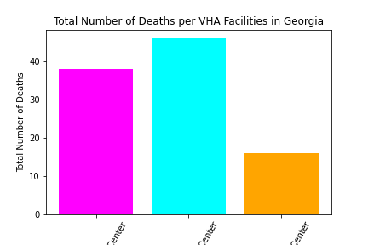
Death Rate by Hospitals in Georgia and Virginia
Objective
Compare Death Rates between VHA Facilities in Georgia and Virginia and how they compare to the national average. Calculate rates by taking the average of all the rates provided and the sum of the total death counts. This can help U.S Veterans make a more informed decision on which VA hospital he/she would prefer to be treated for their condition.
Conclusion
There isn’t a significant difference between the death rates between hospitals within the same state, with the exception of the Atlanta VHA Facility with a death rate of 7.26, while all the others are above 8%.
The 3 facilities in Georgia have a lower combined death rate average than the facilities in Virginia. (7.99% and 8.58% respectively.) Virginia’s average is higher than the national average which is 8.52%.
While the death counts in Virginia are 50% higher than that of Georgia’s, the death rate average is only 1.5% higher than Georgia’s, leading us to conclude that the Virginia facilities see a larger amount of patients that those in Georgia.
The Atlanta VA Facility has the most deaths, but the lowest death rate percentage, meaning they see more patients than the rest of the VA Facilities in Georgia.

